Slide 1
Sex & Identity
Leadership Summit

Slide 2
Friday Evening Session #1
Introduction

Slide 3
Friday Evening Session #2
The Power of Shame

Slide 4
“And the man and his wife were both naked, but they were not ashamed.”
― Genesis 2:25

Slide 5
“Shame is the raincoat of the soul, repelling the living water that would otherwise establish us as the beloved of God.”
― Andrew Comiskey, Strength In Weakness

Slide 6
Then the eyes of both of them were opened, and they knew that they were naked; and they sewed fig leaves together and made themselves loin coverings.
― Genesis 3:7

Slide 7
Then the Lord God called to the man, and said to him, “Where are you?” He said, “I heard the sound of You in the garden, and I was afraid because I was naked; so I hid myself.” And He said, “Who told you that you were naked? Have you eaten from the tree of which I commanded you not to eat?” The man said, “The woman whom You gave to be with me, she gave me from the tree, and I ate.”
― Genesis 2:25

Slide 8
The Woman of Samaria
“If you knew the gift of God, and who it is who is saying to you, ‘Give Me a drink,’ you would have asked Him, and He would have given you living water”.
― John 4:10

Slide 9
“When the people saw this, they all began to complain, saying, ‘He has gone in to be the guest of a man who is a sinner!’ But Zaccheus stopped and said to the Lord, ‘Behold, Lord, half of my possessions I am giving to the poor, and if I have extorted anything from anyone, I am giving back four times as much.’ And Jesus said to him, ‘Today salvation has come to this house, because he, too, is a son of Abraham. For the Son of Man has come to seek and to save that which was lost.’” ― Luke 19:7-10

Slide 10
“Chronic shame is synonymous with a pervasive sense of not being wanted.”
― Andrew Comiskey, Strength In Weakness

Slide 11
“Vulnerability is the birthplace of love, belonging, joy, courage, empathy, and creativity. It is the source of hope, empathy, accountability, and authenticity. If we want greater clarity in our purpose or deeper and more meaningful spiritual lives, vulnerability is the path.”
― Brené Brown, Daring Greatly: How the Courage to Be Vulnerable Transforms the Way We Live, Love, Parent, and Lead

Slide 12
Saturday
Session #1
Understanding Brokenness
in the Church

Slide 13
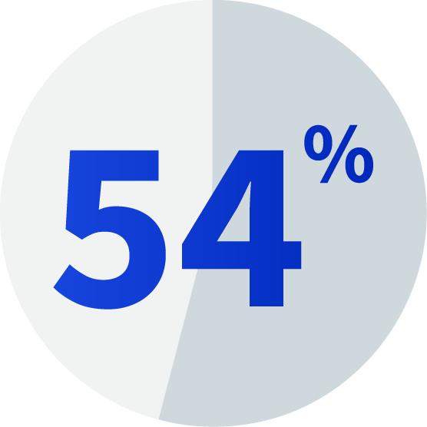
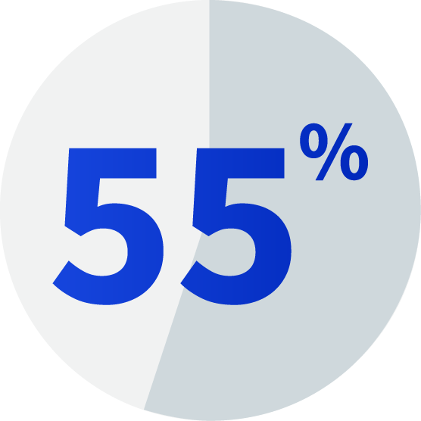
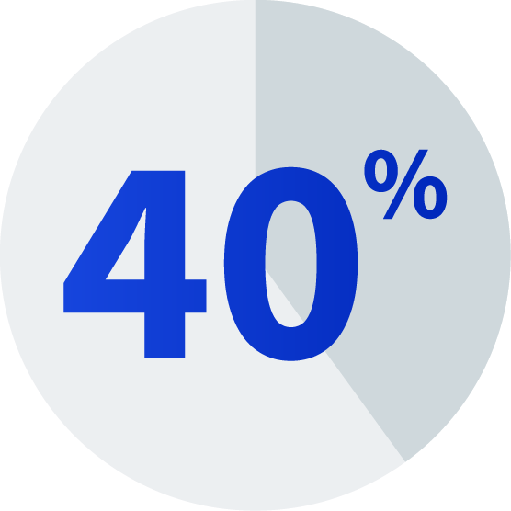
State of The Church
American Christian men view porn at least monthly
(Source: 2014 Proven Men Survey)
American Christian men who are married look at porn monthly
(Source: 2014 Proven Men Survey)
Decline in American Christian church attendance since 2009
(Source: 2020 Barna Survey)

Slide 14
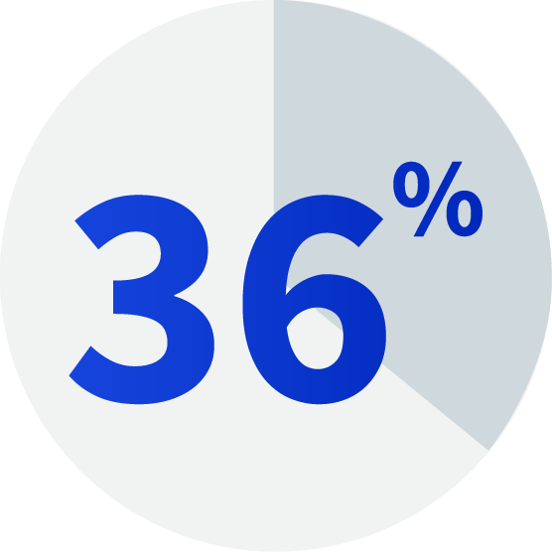
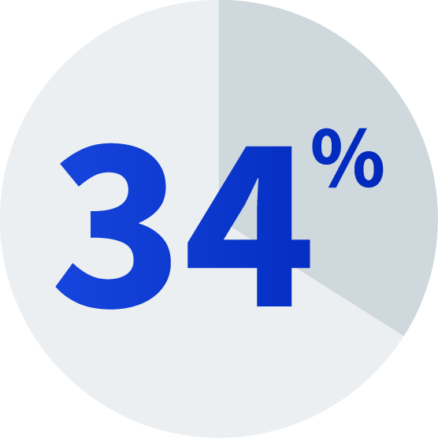
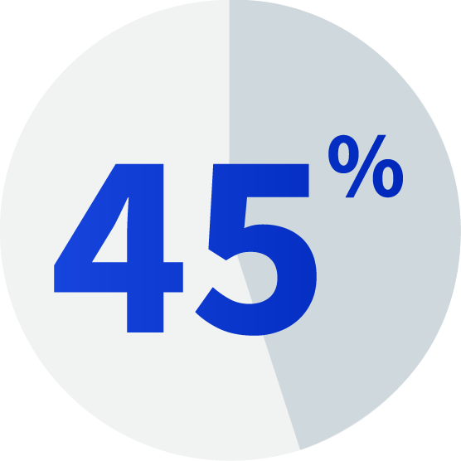
State of The Church
American Christian women view porn at work at least monthly
(Source: 2014 Proven Men Survey)
American Christian women age 18-30 view porn at least monthly
(Source: 2014 Proven Men Survey)
American girls view porn before age 16
(Source: 2014 Proven Men Survey)

Slide 15
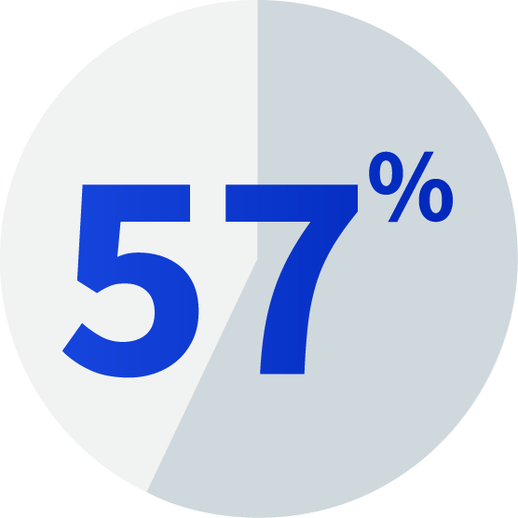
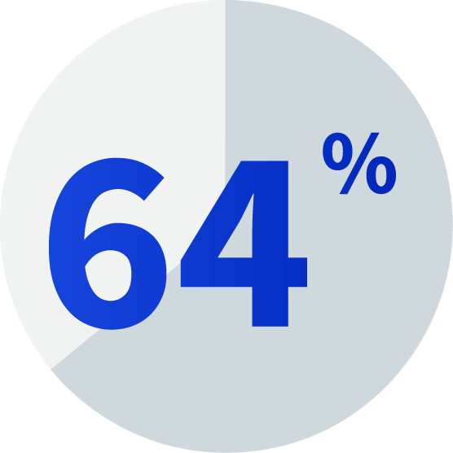
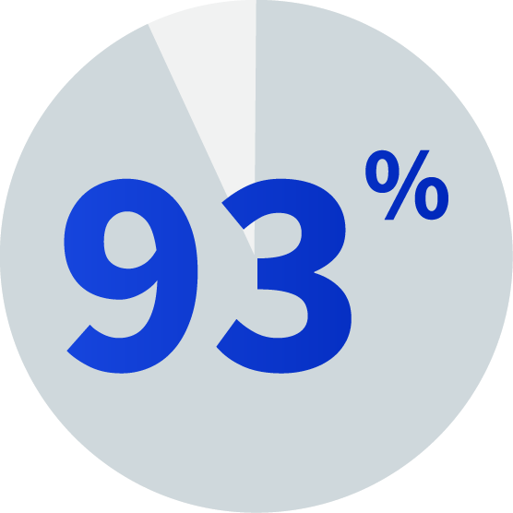
State of Church Leadership
American Pastors have struggled with &/or view porn regularly
(Source: 2016 Barna Survey)
American Youth Pastors have struggled with &/or view porn regularly
(Source: 2016 Barna Survey )
American Pastors say porn is a bigger problem today than in the past
(Source: 2016 Barna Survey )

Slide 16
The Sexual Revolution

Slide 17
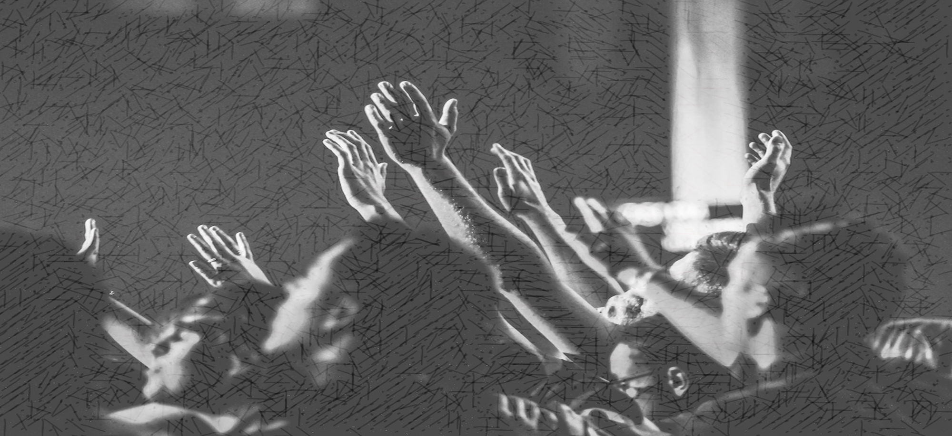
Sex & Relationships Divorced From God
Devaluation of Life
Sex Addiction
Sexually Transmitted Diseases
Soul Sickness
Spiritual Brokenness
Sexual Abuse

Slide 18
Saturday
Session #2
Changing Church Culture/ Preparing the Soil
Safe & Transformational Environments

Slide 19
Personal Evaluation
Image Management
Matt 23:25-28

Slide 20
Woe to you, scribes and Pharisees, hypocrites! For you clean the outside of the cup and of the dish, but inside they are full of robbery and self-indulgence. You blind Pharisee, first clean the inside of the cup and of the dish, so that the outside of it may become clean also.
Matthew 23:25-26

Slide 21
Woe to you, scribes and Pharisees, hypocrites! For you are like whitewashed tombs which on the outside appear beautiful, but inside they are full of dead men’s bones and all uncleanness. So you, too, outwardly appear righteous to men, but inwardly you are full of hypocrisy and lawlessness.
Matthew 23:27-28

Slide 22
Corporate Evaluation
Soil Test
Luke 8:11-15

Slide 23
The seed is the word of God. Those beside the road are those who have heard; then the devil comes and takes away the word from their heart, so that they will not believe and be saved. Those on the rocky soil are those who, when they hear, receive the word with joy; and these have no firm root; they believe for a while, and in time of temptation fall away.
Luke 8:11-13

Slide 24
The seed which fell among the thorns, these are the ones who have heard, and as they go on their way they are choked with worries and riches and pleasures of this life, and bring no fruit to maturity. But the seed in the good soil, these are the ones who have heard the word in an honest and good heart, and hold it fast, and bear fruit with perseverance.
Luke 8:14-15

Slide 25
Then God said, “Let us make mankind in our image, in our likeness, so that they may rule over the fish in the sea and the birds in the sky, over the livestock and all the wild animals, and over all the creatures that move along the ground.” So God created mankind in his own image, in the image of God he created them; male and female he created them.
Genesis 1:26-27

Slide 26
Restoring Sexual & Relational Wholeness
How?

Slide 27
Sexual & Relational Wholeness

Slide 28
Sexual & Relational Wholeness
I am the vine, you are the branches; he who abides in Me and I in him, he bears much fruit, for apart from Me you can do nothing.
John 15:5

Slide 29
Sexual & Relational Wholeness
Then Jesus said to His disciples, “If anyone wishes to come after Me, he must deny himself, and take up his cross and follow Me.”
Matthew 16:24

Slide 30
Sexual & Relational Wholeness
For each one will bear his own load.
Galatians 6:5

Slide 31
Sexual & Relational Wholeness
Bear one another’s burdens, and thereby fulfill the law of Christ.
Galatians 6:2

Slide 32
Sexual & Relational Wholeness
Therefore, confess your sins to one another, and pray for one another so that you may be healed. The effective prayer of a righteous man can accomplish much.
James 5:16

Slide 33
Sexual & Relational Wholeness
But if we walk in the Light as He Himself is in the Light, we have fellowship with one another, and the blood of Jesus His Son cleanses us from all sin.
1 John 1:7

Slide 34
Sexual & Relational Wholeness
Take care, brethren, that there not be in any one of you an evil, unbelieving heart that falls away from the living God. But encourage one another day after day, as long as it is still called “Today,” so that none of you will be hardened by the deceitfulness of sin.
Hebrews 3:12-13

Slide 35
Sexual & Relational Wholeness

Slide 36
Sexual & Relational Wholeness
Vulnerable & Authentic
Relationship are Needed for:
Prevention
Recovery

Slide 37
Saturday
Session #3
LGBTQ+ A Biblical, Vital, Compassionate Response from the Church

Slide 38
LGBTQIA2S+
L = Lesbian
G = Gay
B = Bisexual
T = Transgender
Q = Queer/Questioning
I = Intersex
A = A-sexual
2S = Two-spirit
+ = All other gender identities not yet described in letters

Slide 39
Transgender
An umbrella term used to describe the incongruence or dysphoria felt in regard to one’s biological sex
There can be a wide variety of responses to one’s feelings of misalignment between their sex and sense of gender identity
Surgical and/or chemical intervention is nearly always the common response. Counseling that could explore the possibility of trauma or other contributing factors is considered unethical

Slide 40
Intersex
Intersex people are born with physical, hormonal and/or genetic features that are neither wholly female nor wholly male, or are a combination of female and male
1.7% - Common as red hair (Anne Fausto-Sterling, Brown University)
There is a flaw in Fausto-Sterling’s 1.7 percent statistic; namely, that it included many conditions that cannot be considered intersex in any clinically relevant sense
0.018% - actual occurrence of intersex (Leonard Sax, MD, Ph.D)

Slide 41
Asexuality
“Unlike celibacy, which is a choice to abstain from sexual activity, asexuality is an intrinsic part of who we are, just like other sexual orientations”
(Asexual Visibility & Education Network)
Claims of sexual orientation
God designed sexual expression for marriage
An often-ignored issue
Often (not always) connected to past sexual abuse

Slide 42
Two Spirit
Two Spirit is an umbrella term specifically and exclusively for Indigenous people who identify as LGBTQIA+
Describes an indigenous person who is believed to have both a masculine and feminine spirit - hence Two Spirit

Slide 43
+ Polyamory/Non-monogamy
Consensual non-monogamy is the open practice of multiple sexual and/or romantic partners
The APA has now formulated a task force to study polyamory in hopes of removing the “stigma” associated with it, and have even given the lifestyle its own politically correct term – “consensual non-monogamy”
“This is the entirely expected and predicted consequence of what happens when ideology replaces science. The APA is yet again showing us that they are a professional guild and not a scientific organization.” Andre Van Mol, Physician

Slide 44
+ Pedophilia
Sexual and/or romantic attraction to children
This can involve attraction to pre or post- pubescent children – usually one or the other
Minor attracted person (MAP) – a new description designed to lower stigma and develop a culturally accepted sexual orientation
The logical end of the “love is love” phrase

Slide 45
+ Trans-Species/Furries
An individual who identifies themselves as a particular animal, reptile, or fantasy creature
We are seeing a disturbing and growing trend on social media and in public schools toward kids identifying as trans-species

Slide 46
State of The Culture
39% of 18-24 year-olds in the US identify as LGBTQ+
(Source: 2021 ACU Cultural Research Center Survey)

Slide 47
Jesus Died For All
John 3:16 – For God so loved…
“For God so loved the world, that He gave His only begotten Son, that whoever believes in Him shall not perish, but have eternal life”

Slide 48
Jesus Died For All
John 3:16 – For God so loved…
Luke 15 – The Pharisees
The lost sheep
The lost coin
The lost son

Slide 49
When the scribes of the Pharisees saw that He was eating with the sinners and tax collectors, they said to His disciples, Why is He eating and drinking with tax collectors and sinners? And hearing this, Jesus said to them, It is not those who are healthy who need a physician, but those who are sick; I did not come to call the righteous, but sinners.
Mark 2:16-17

Slide 50
For this reason God gave them over to degrading passions; for their women exchanged the natural function for that which is unnatural and in the same way also the men abandoned the natural function of the woman and burned in their desire toward one another, men with men committing indecent acts and receiving in their own persons the due penalty of their error.
Romans 1:26-27

Slide 51
Or do you not know that the unrighteous will not inherit the kingdom of God? Do not be deceived; neither fornicators, nor idolaters, nor adulterers, nor effeminate, nor homosexuals, nor thieves, nor the covetous, nor drunkards, nor revilers, nor swindlers, will inherit the kingdom of God.
1 Corinthians 6:9-10

Slide 52
Such were some of you; but you were washed, but you were sanctified, but you were justified in the name of the Lord Jesus Christ and in the Spirit of our God.
1 Corinthians 6:11

Slide 53
“A woman shall not wear man’s clothing, nor shall a man put on a woman’s clothing; for whoever does these things is an abomination to the LORD your God”.
Deuteronomy 22:5

Slide 54
“Does not even nature itself teach you that if a man has long hair, it is a dishonor to him, but if a woman has long hair, it is a glory to her? For her hair was given to her for a covering”.
1 Corinthians 11:14-15

Slide 55
Love is patient, love is kind. It does not envy, it does not boast, it is not proud. It does not dishonor others, it is not self-seeking, it is not easily angered, it keeps no record of wrongs. 6 Love does not delight in evil but rejoices with the truth. 7 It always protects, always trusts, always hopes, always perseveres.
1 Corinthians 13:4-6

Slide 56
Four Questions to Consider
Are We Living The Life We’re Inviting Others Into?

Slide 57
Four Questions to Consider
Are We Preparing The Soil of Our Churches?

Slide 58
Four Questions to Consider
Are We Inviting People to Genuine Repentance?

Slide 59
Four Questions to Consider
Are We Actually Loving Others Honestly & Well?

Slide 60
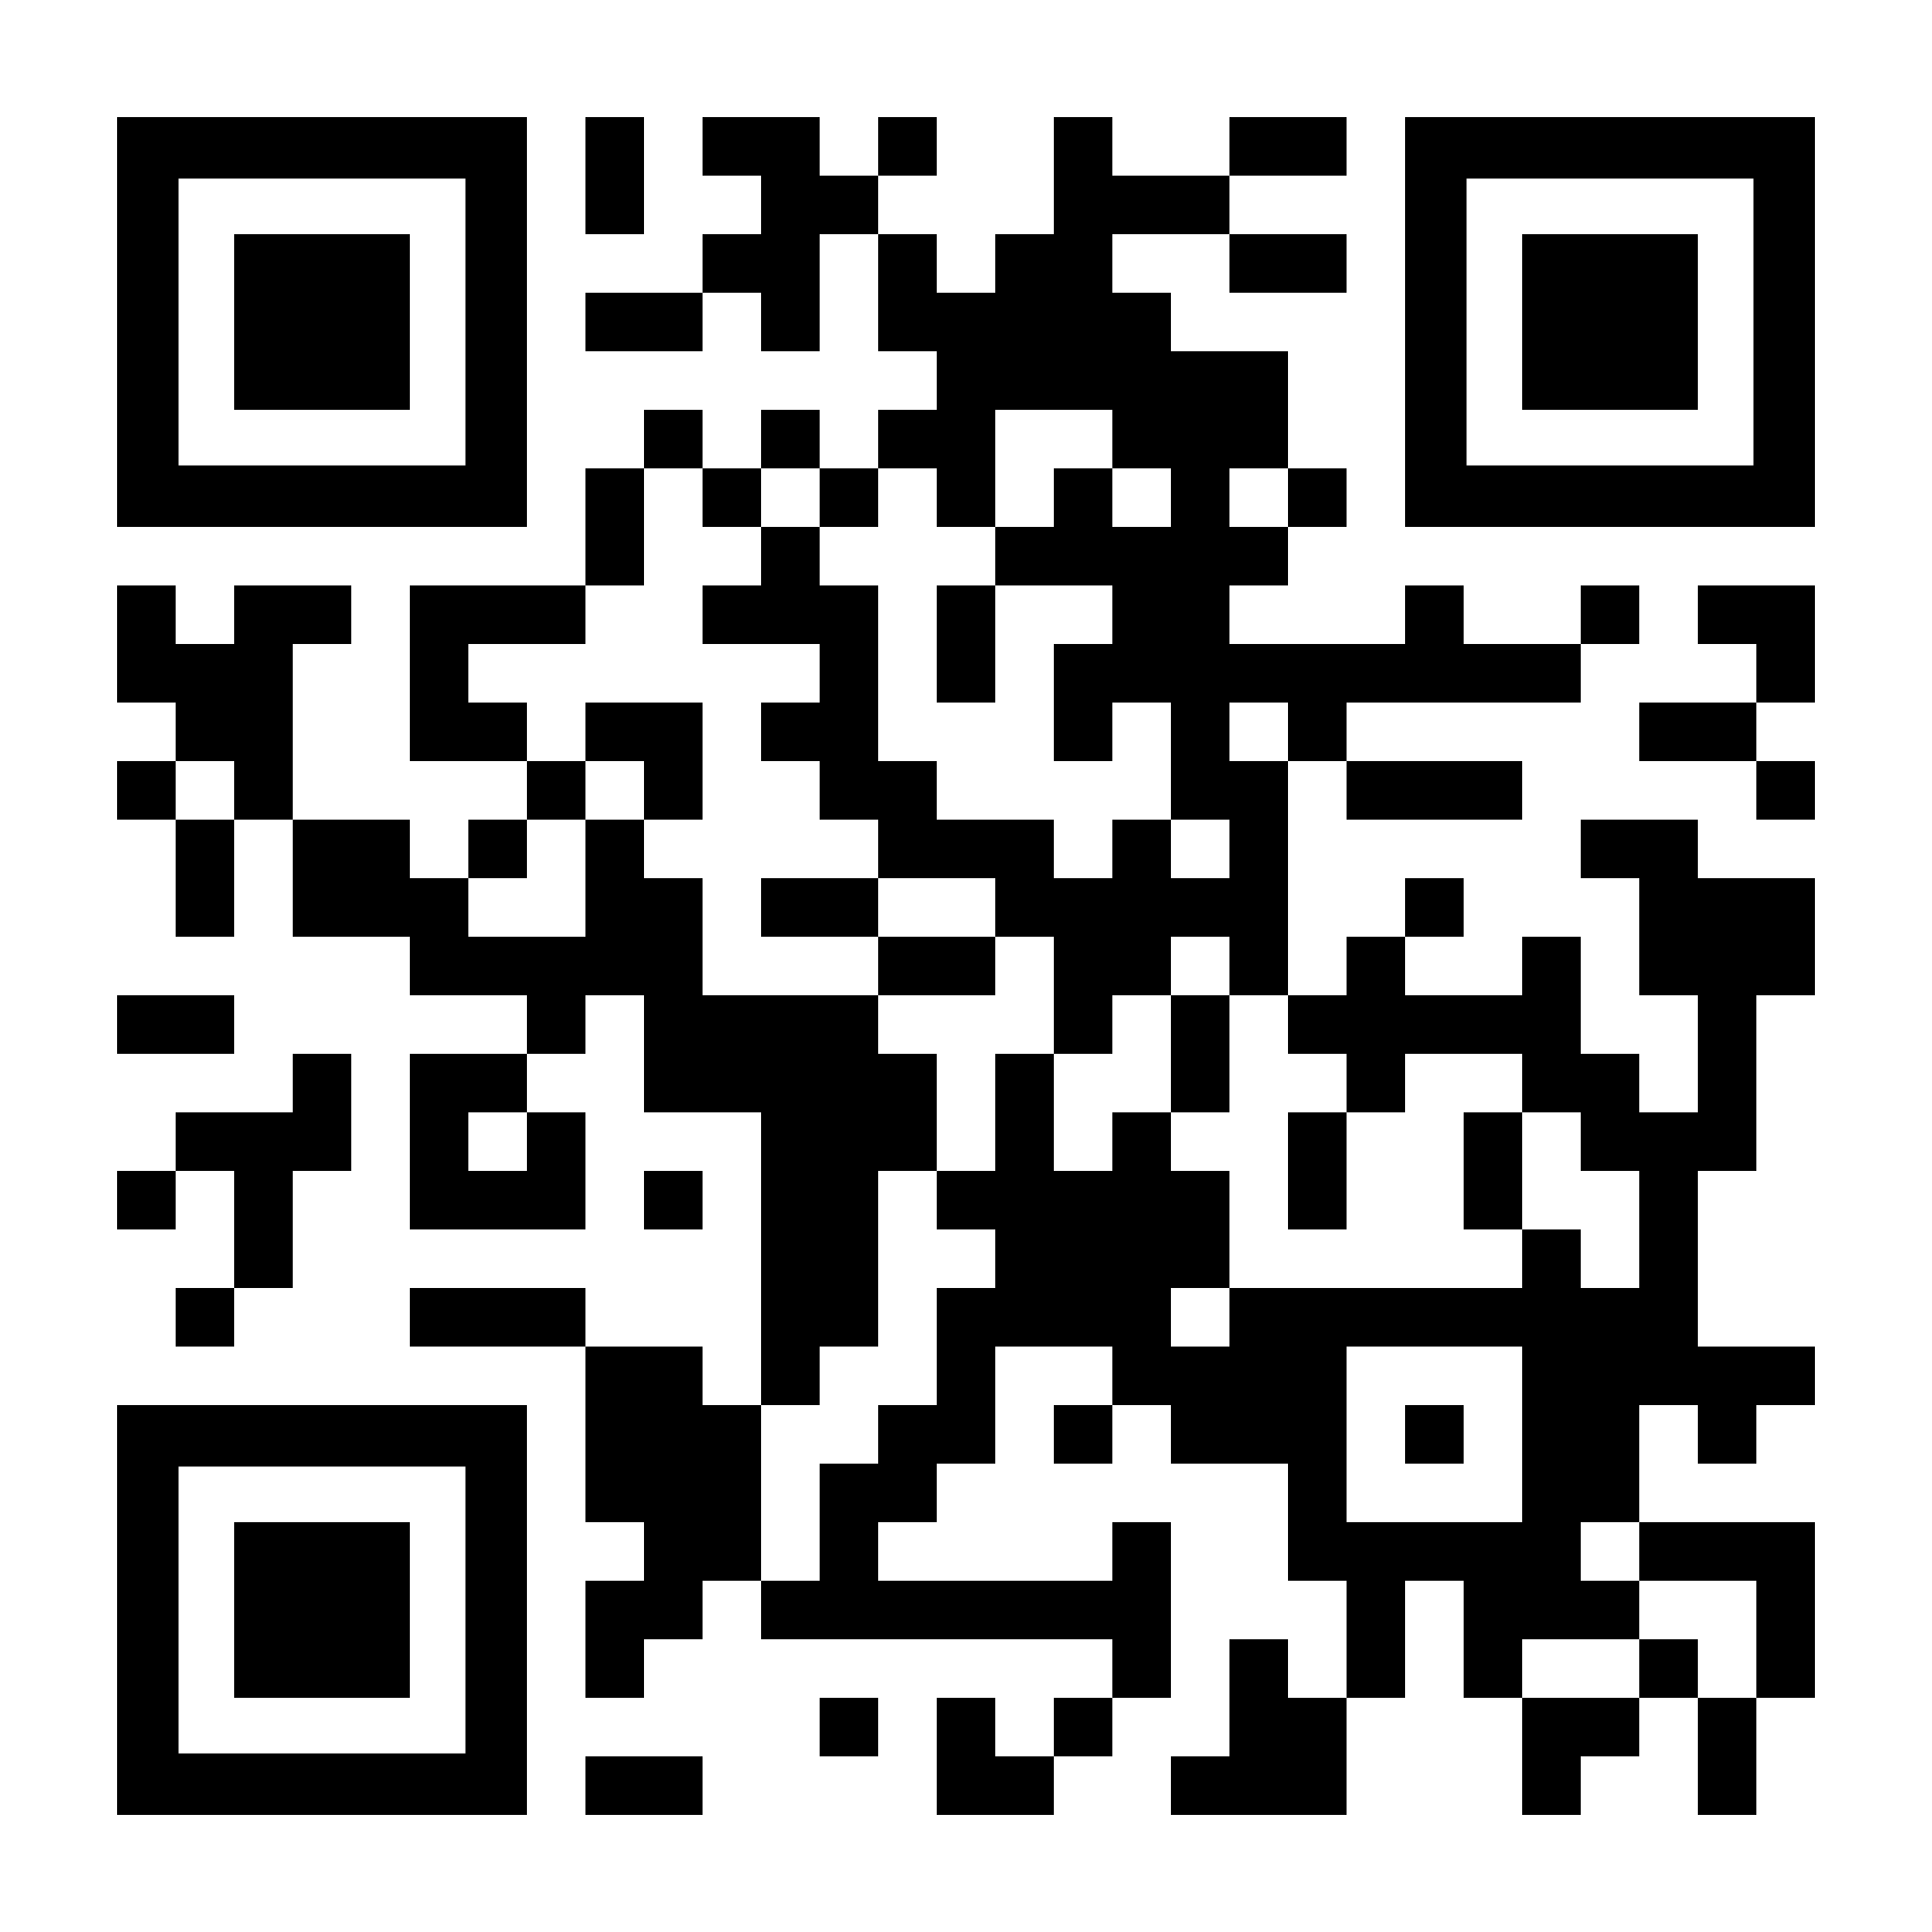
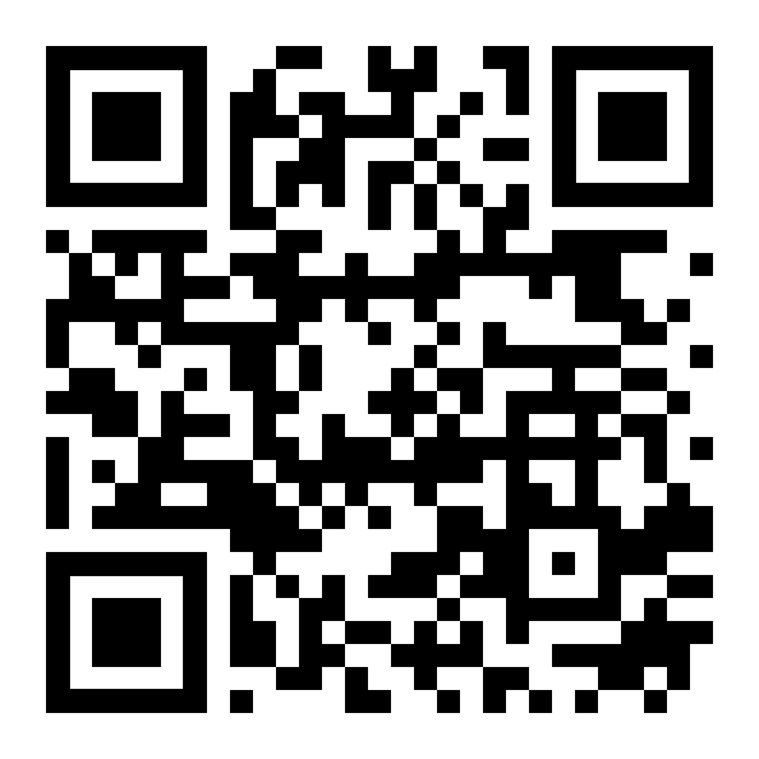
Get Our Newsletter
Donate
Quarterly Ministry Updates
Special Offers & Event Invites
Access to the Newest Resources
Help us continue reaching even more people
Get a tax-deductible receipt
LoveAndTruthNetwork.com/Newsletter
LoveAndTruthNetwork.com/Donate

