Slide 1
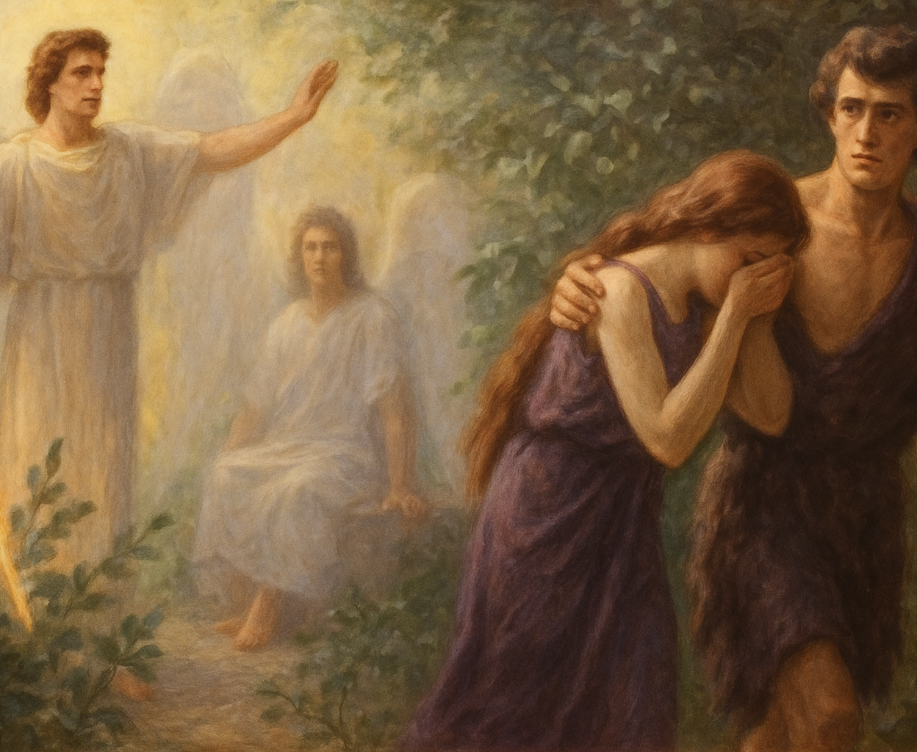
Mental Health 2025
A Christian journey for you, me and our loved ones
Jonathan Yeh, MD
Methuen, MA, USA

Slide 2
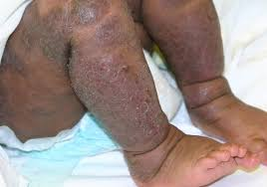
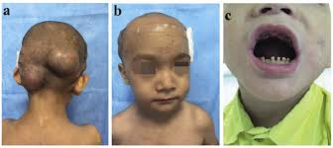
Job: terrible physical signs and even worse mental suffering

Slide 3
Depression into PTSD and suicidal behavior
“I have no peace, no quietness; I have no rest, but only turmoil”
Job 3:26 NIV
“even then you frighten me with dreams and terrify me with visions” Job 7:14

Slide 4
The failed therapy intervention
“Oh, how I wish that God would speak, that he would open his lips against you” Job 11:11
“I have heard many things like these; you are miserable comforters, all of you!” Job 16:2

Slide 5
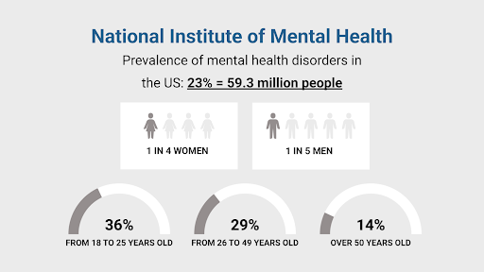

Slide 6
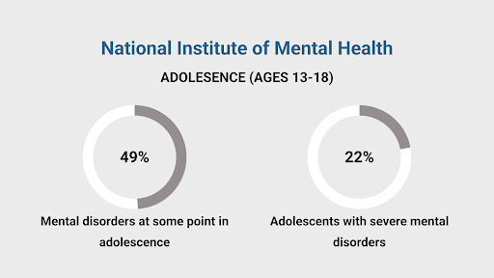

Slide 7
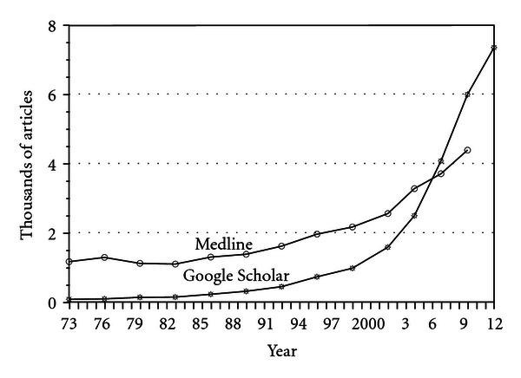

Slide 8
PROPOSAL 1:
“The Spirit of the Lord will rest on him—the Spirit of wisdom and of understanding, the Spirit of counsel and of might, the Spirit of the knowledge and fear of the Lord” Isaiah 11:2
conferences, workshops, resources by mental health care professionals
Proposal 1
Proposal 2
Proposal 3
Conclusion

Slide 9
THE STATE OF PASTORS 2024- BARNAS STUDY
523 Protestant senior pastors of varying ages and denominations (including non-denominational) studied
⅓ :considered quitting in the last year
60 %: significantly doubted their calling
25% :seriously doubted their faith
18%: have contemplated self-harm or suicide within the past year.
59%: they don’t have a private life
65%: no get help from a professional mentor, therapist, or professional counselor,
Proposal 1
Proposal 2
Proposal 3
Conclusion

Slide 10
THE STATE OF PASTORS: PASTOR RESPONSES COMPARING 2015 TO 2023
Pastor Responses | 2015 | 2023
Feel has excellent physical well being | 24% | 11%
Feel excellent mentally and emotionally | 39% | 14%
Having excellent quality of life | 49% | 19%
Feel they have true friends | 34% | 19%
Feel respected from their community | 22% | 7%
Proposal 1
Proposal 2
Proposal 3
Conclusion

Slide 11



PROPOSAL 2:
David asked, “Is there anyone still left of the house of Saul to whom I can show kindness for Jonathan’s sake?” 2 Samuel 9:1
help/support for pastor, wife and children
Proposal 2
Proposal 1
Proposal 3
Conclusion

Slide 12

PROPOSAL 3:
RECONNECTION BETWEEN CLERGY AND HEALTH CARE PROFESSIONALS
Proposal 3
Proposal 1
Proposal 2
Conclusion

Slide 13
THE CASE OF TRIANGLE MODEL IN DALLAS
Pastor
Mental Health Professional
Caregiver
Proposal 3
Proposal 1
Proposal 2
Conclusion

Slide 14

A CASE OF MILLIONS OF YOUTUBE FOLLOWERS
Media outreach church-outside of world
Proposal 3
Proposal 1
Proposal 2
Conclusion

Slide 15
Conclusion
https://drive.google.com/file/d/12Xg6G9jBbSrMNsxdMSqAYSiMfDFcjXaC/view
https://drive.google.com/file/d/12Xg6G9jBbSrMNsxdMSqAYSiMfDFcjXaC/view
Conclusion
Proposal 1
Proposal 2
Proposal 3

Slide 17
https://www.youtube.com/watch?v=Vy4cnl77MdI

